Slide 1


Slide 2
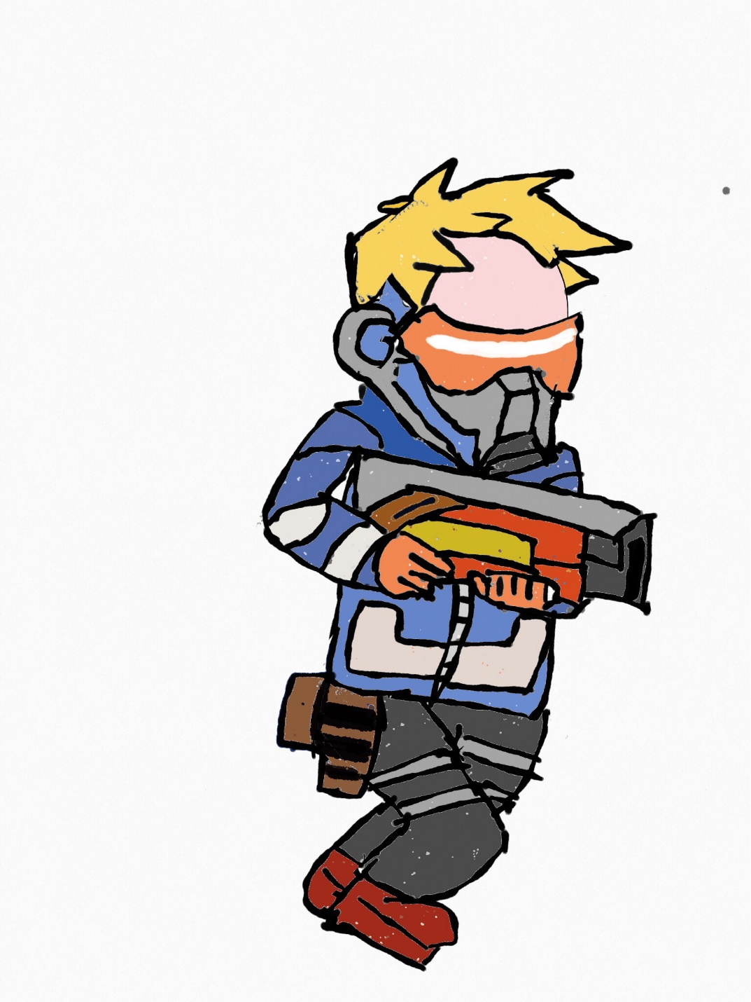
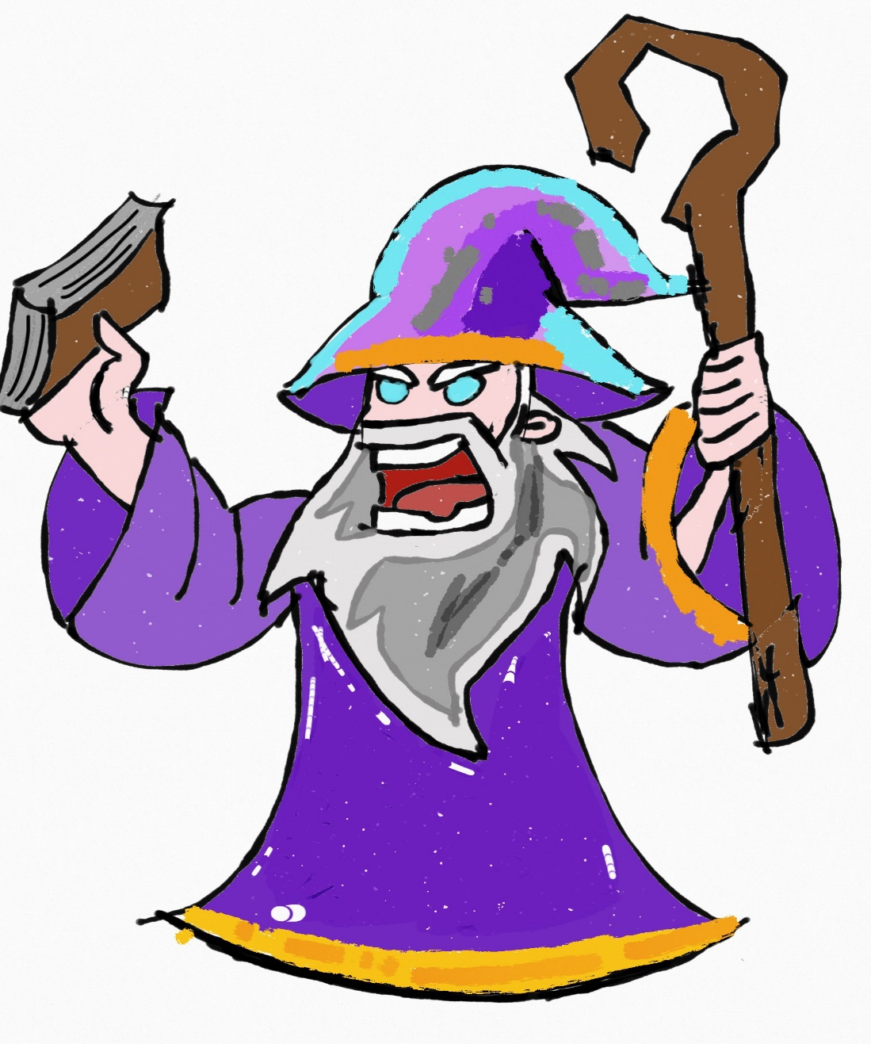
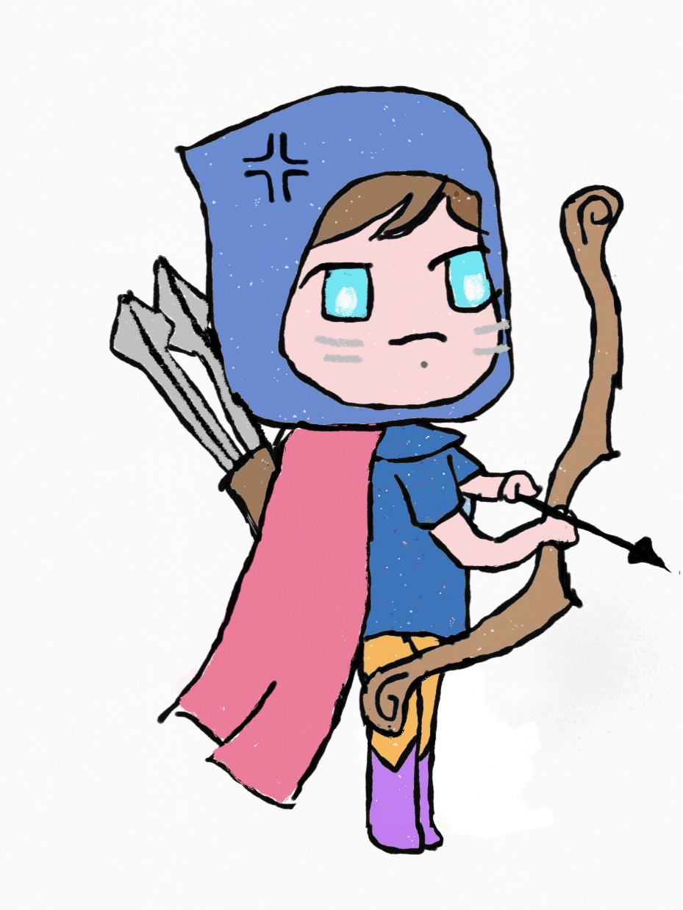

Slide 3
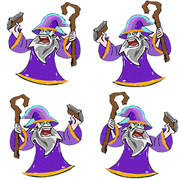
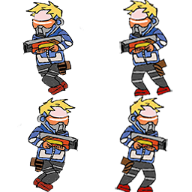
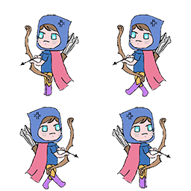

Slide 4
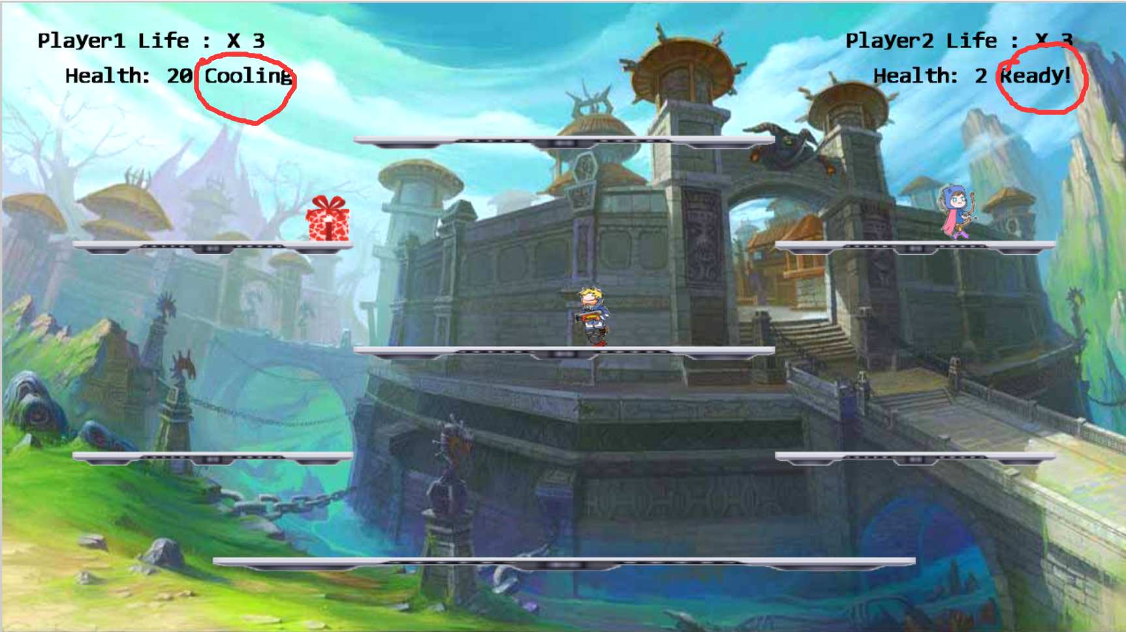

Slide 5
Gift :
Archer : Tracing Arrow
Soldier : Sniper
Wizard : Angry shoot

Slide 6
Player 1 : W A S D
Shoot: Space Gift: E
Player 2: Up, Down, Left, Right Arrows
Shoot: L Gift: K

Slide 7
In short： ri3007b.co.nf/Group8/public_html/
Just Play !
It is Super Fun!!!
Remember : We are Group 8

